Slide 1
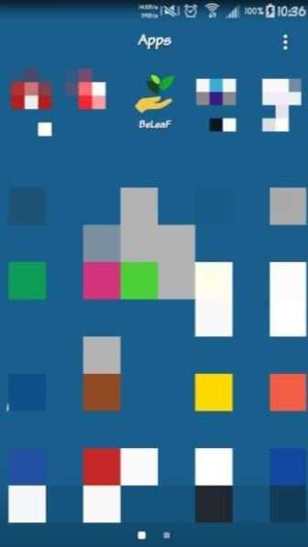
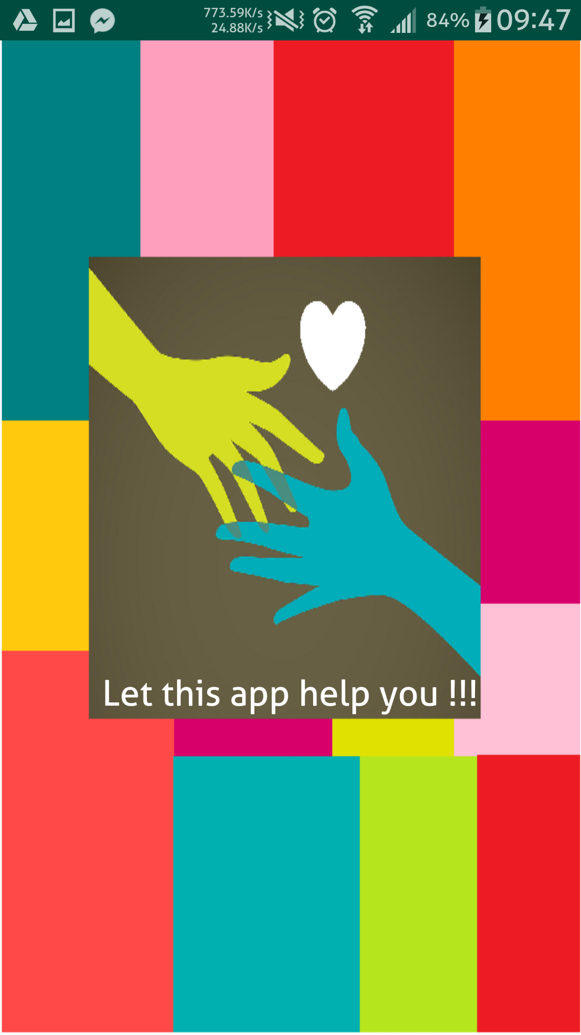
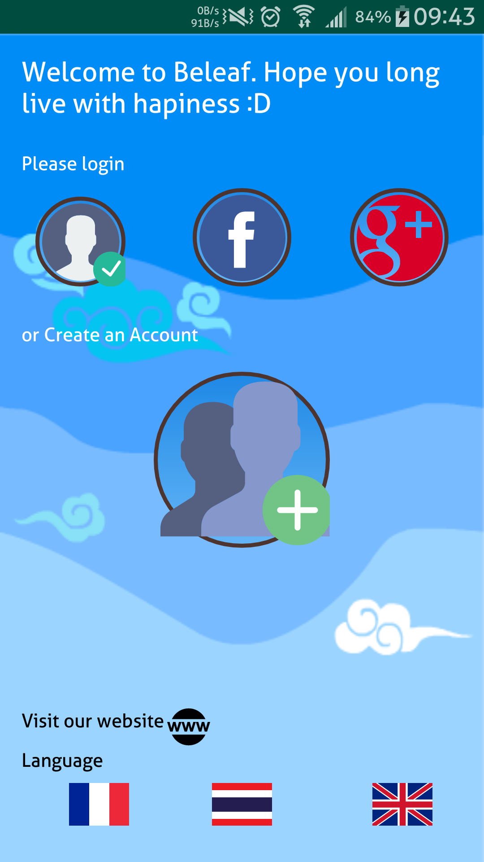
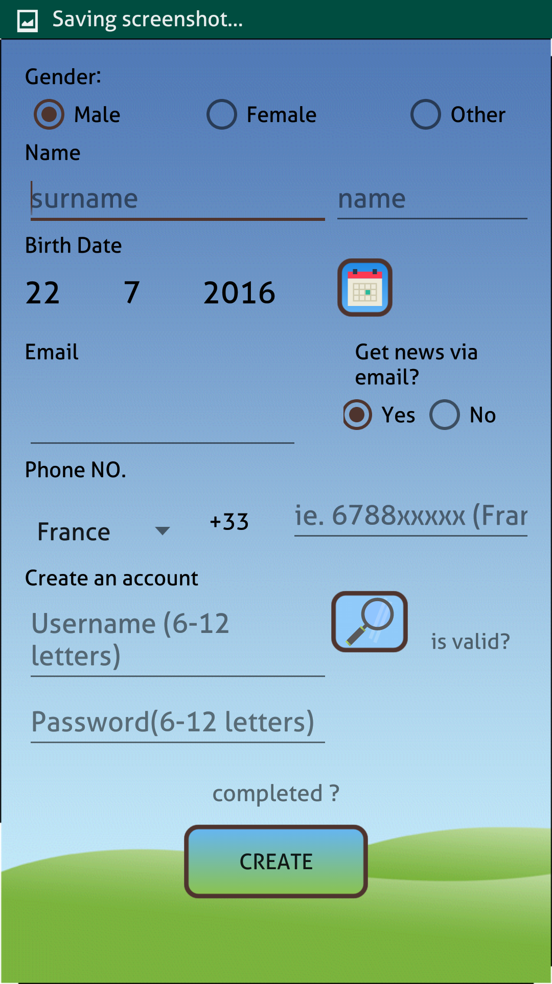
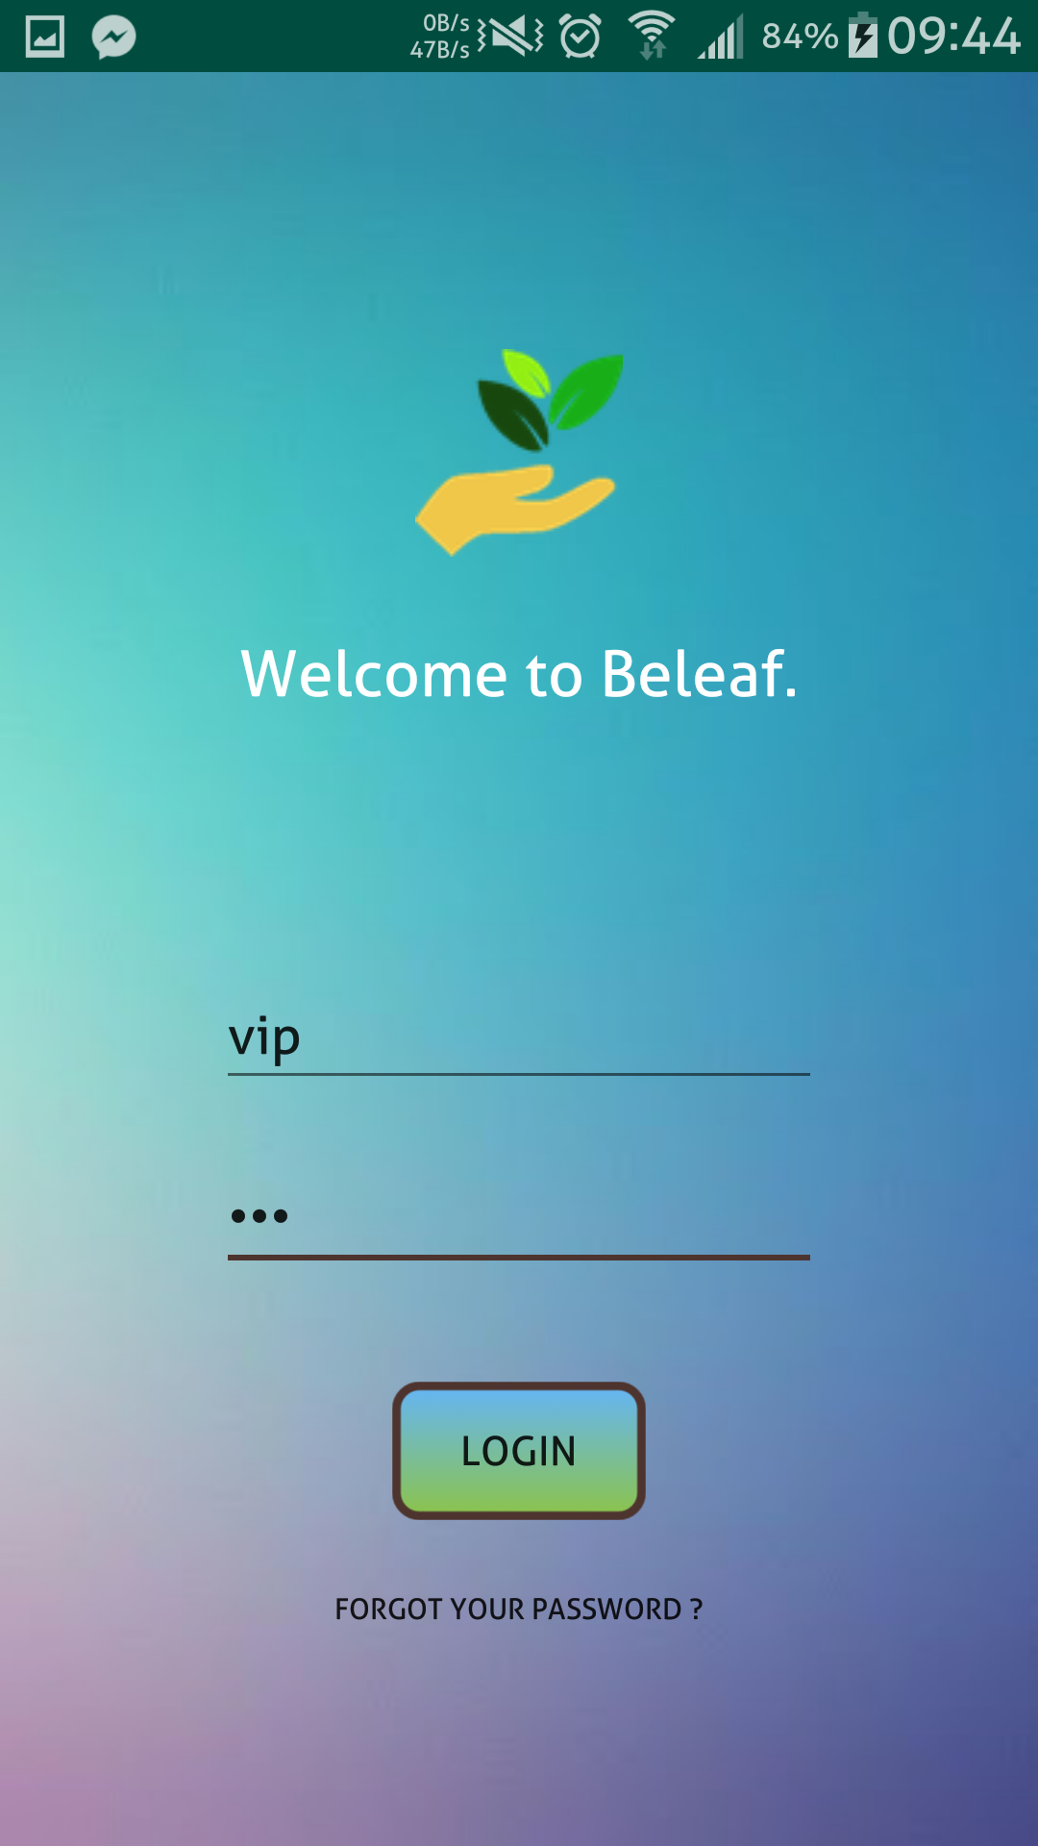
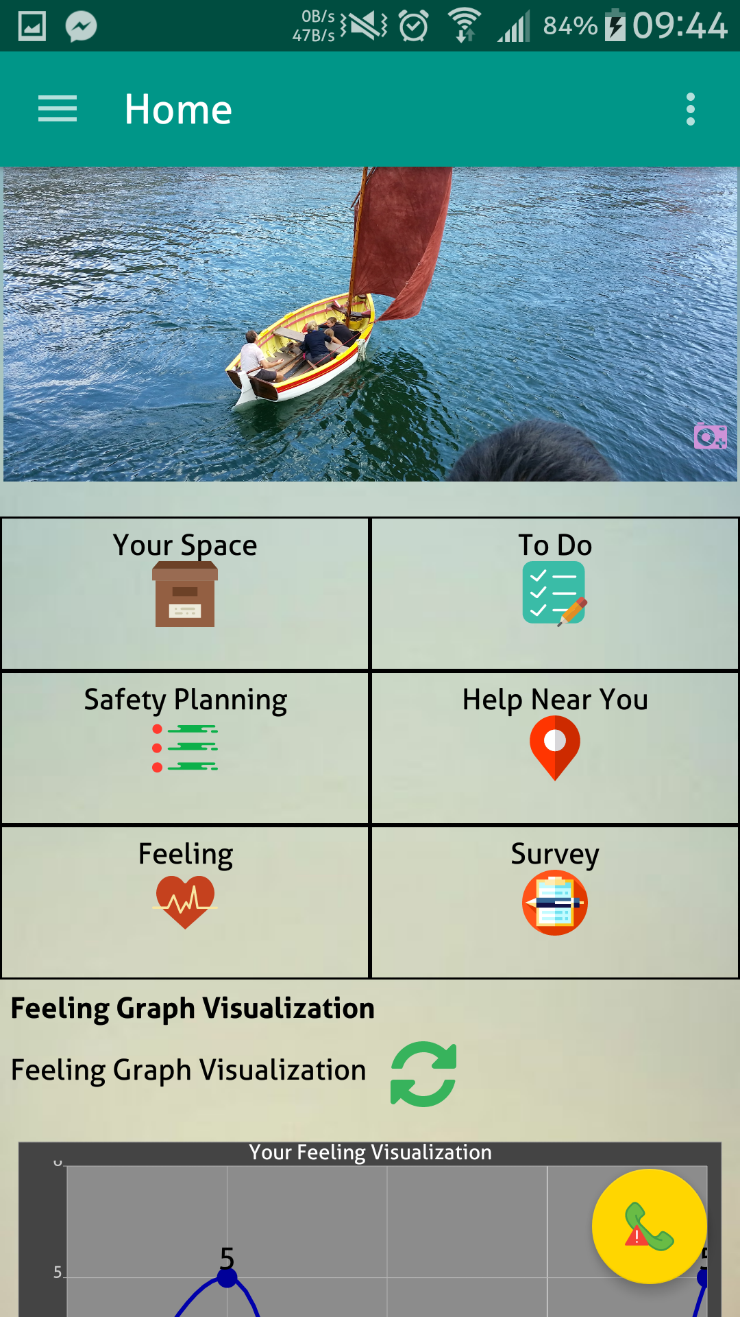
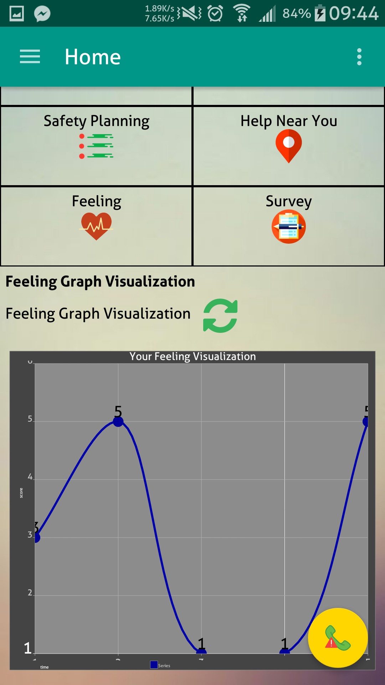
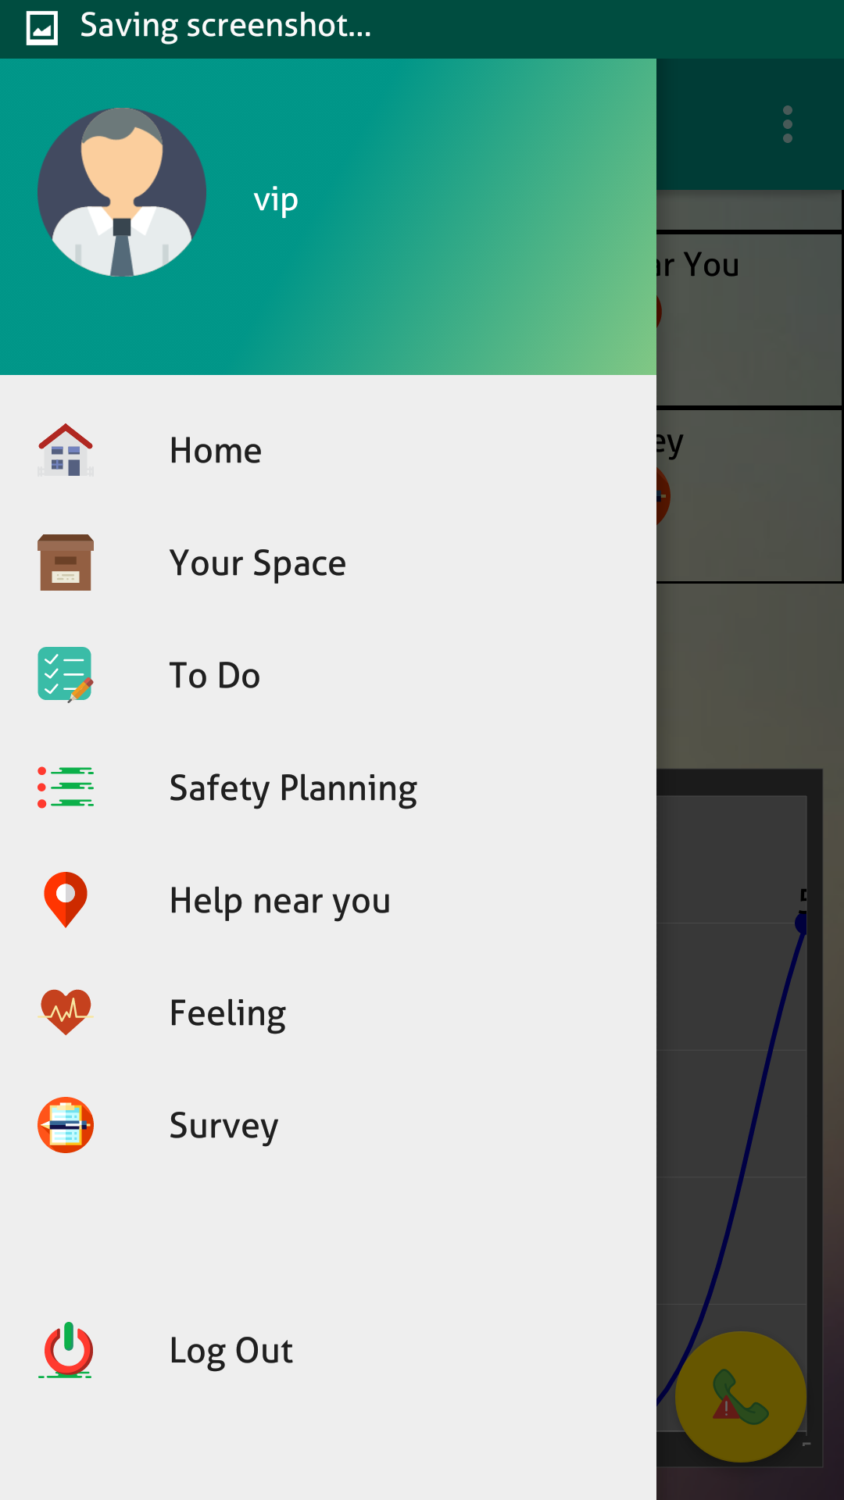
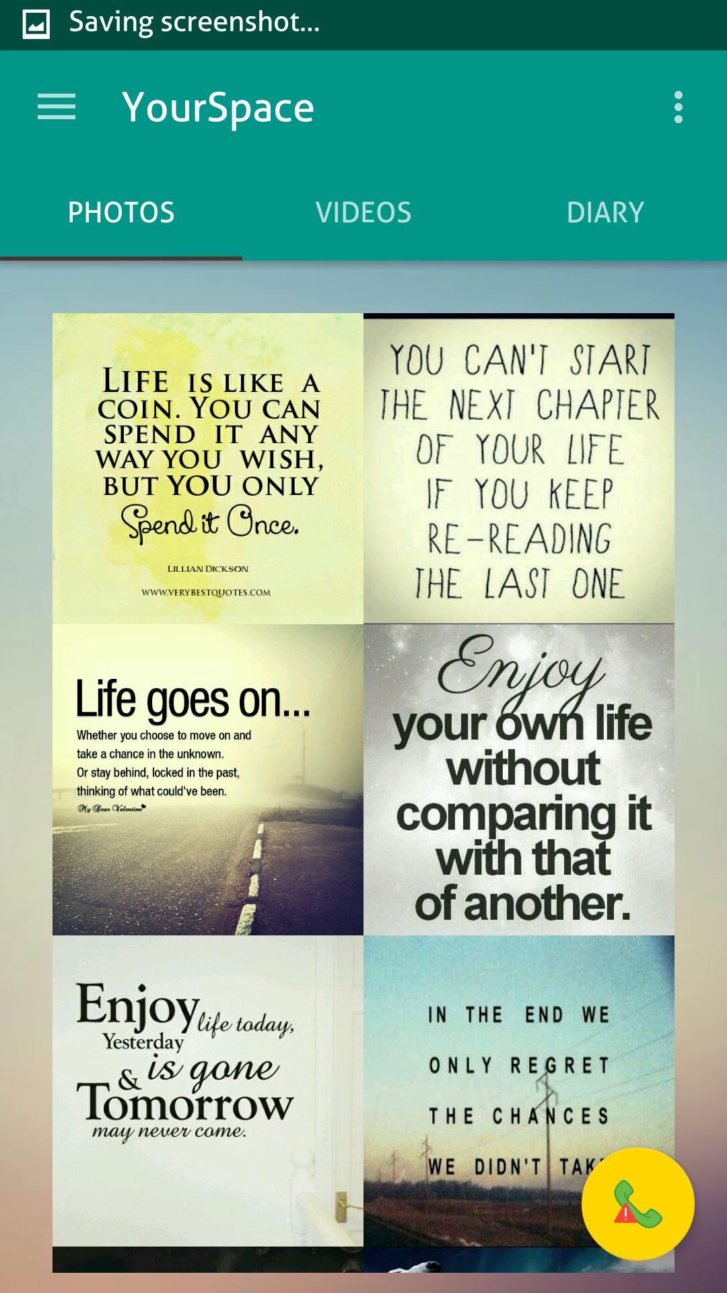
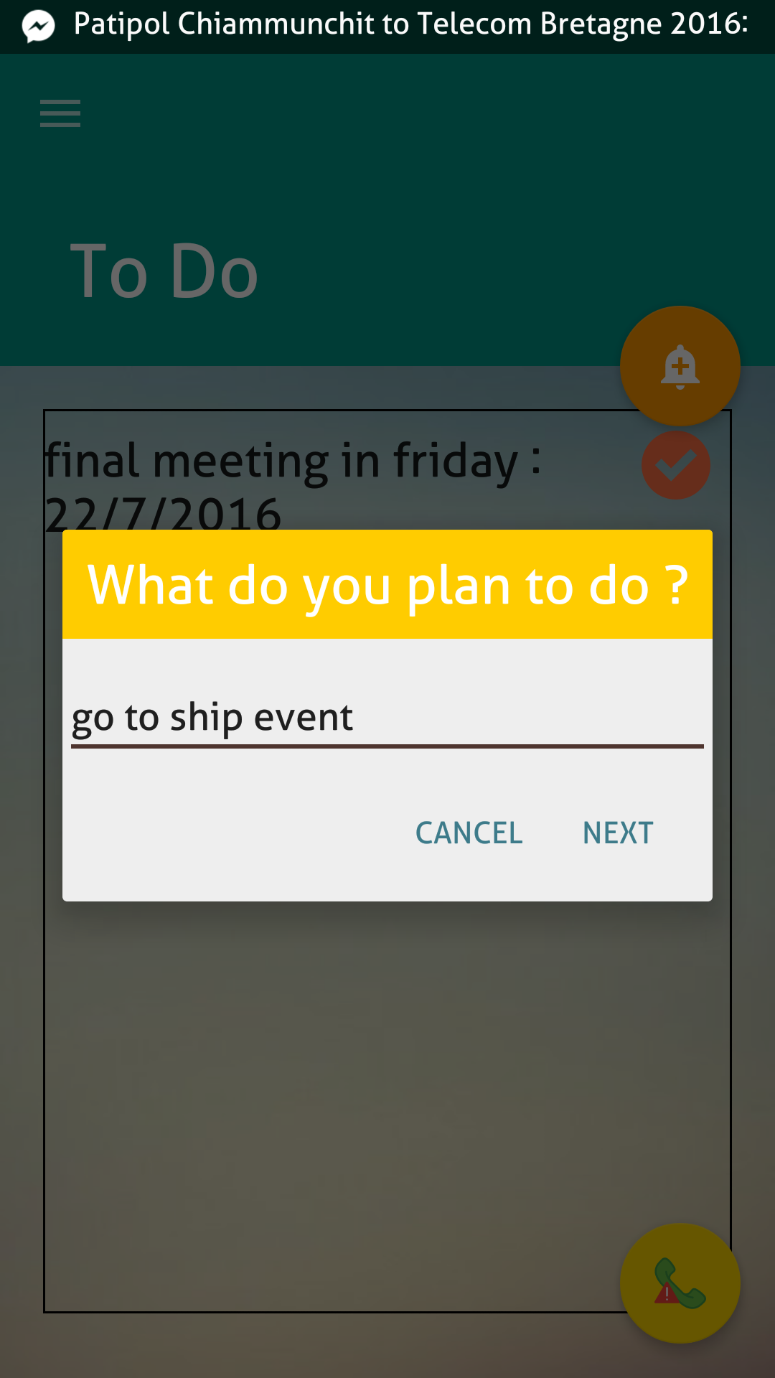
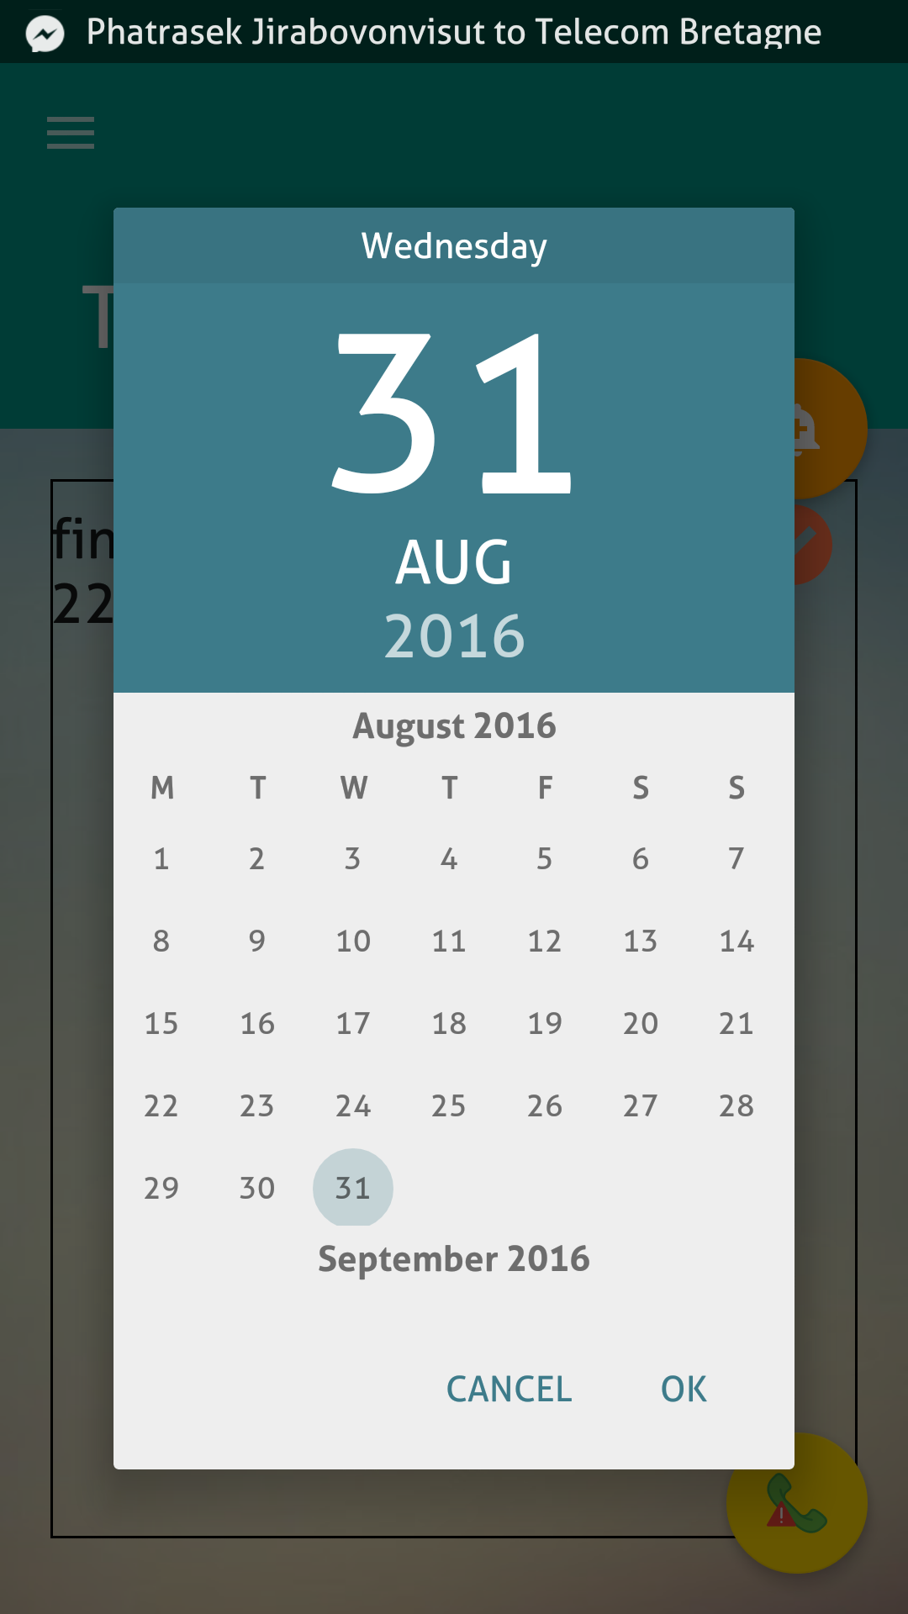
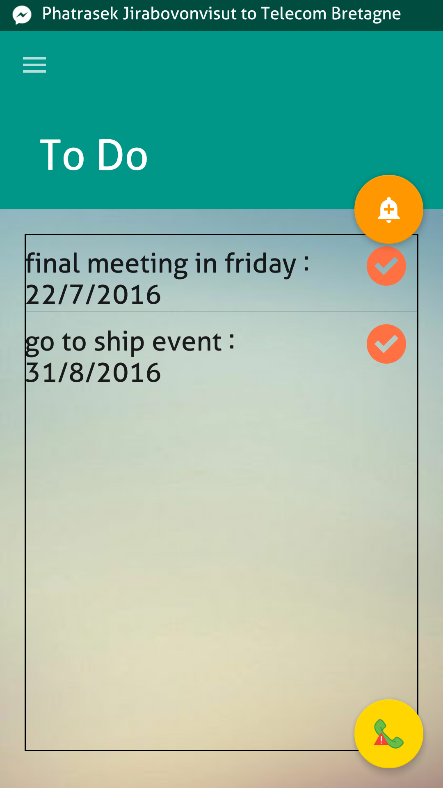
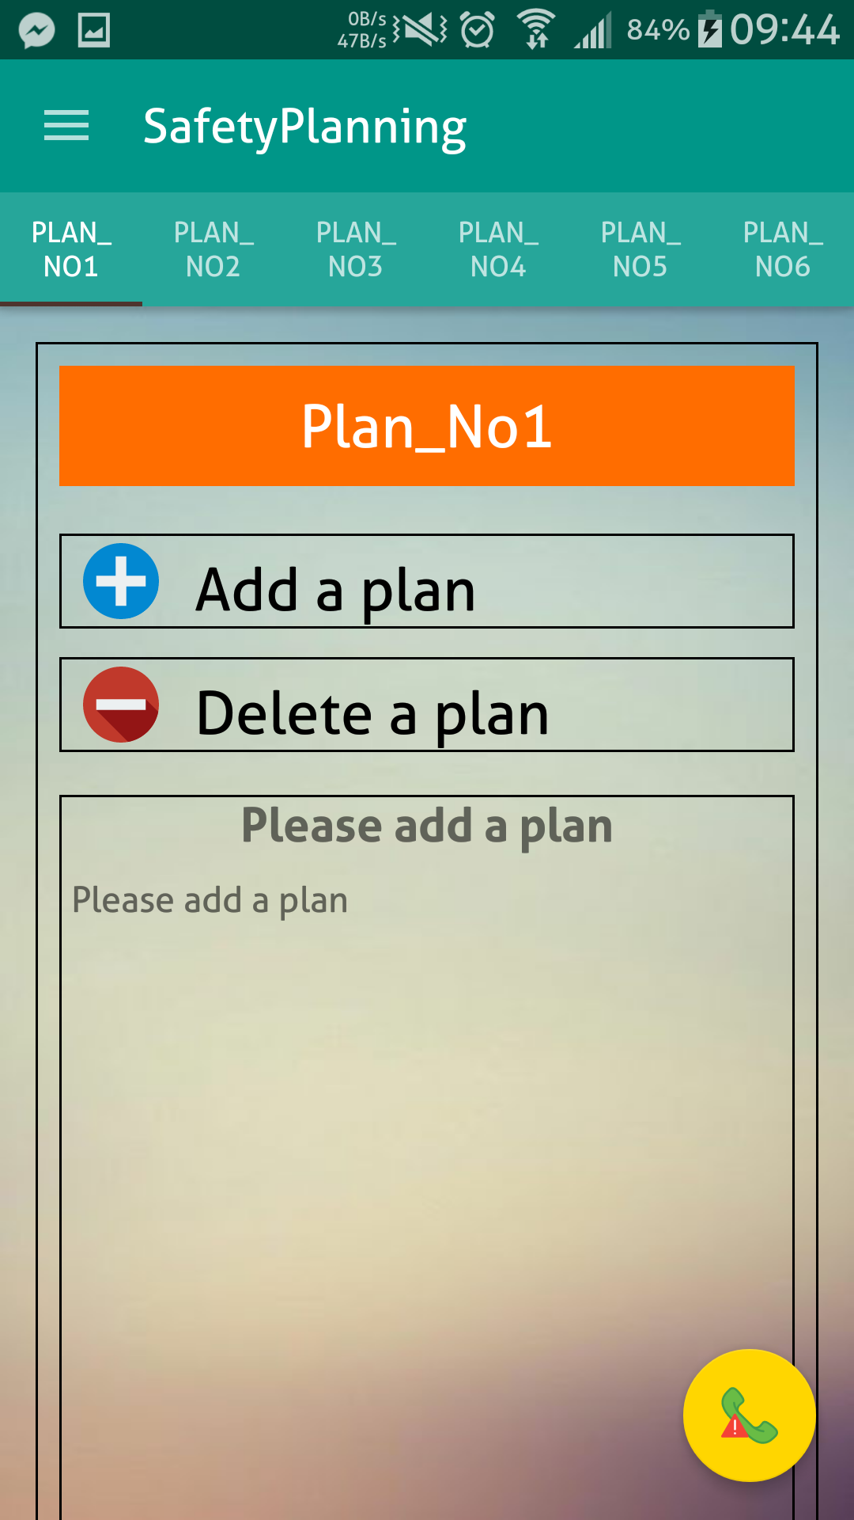
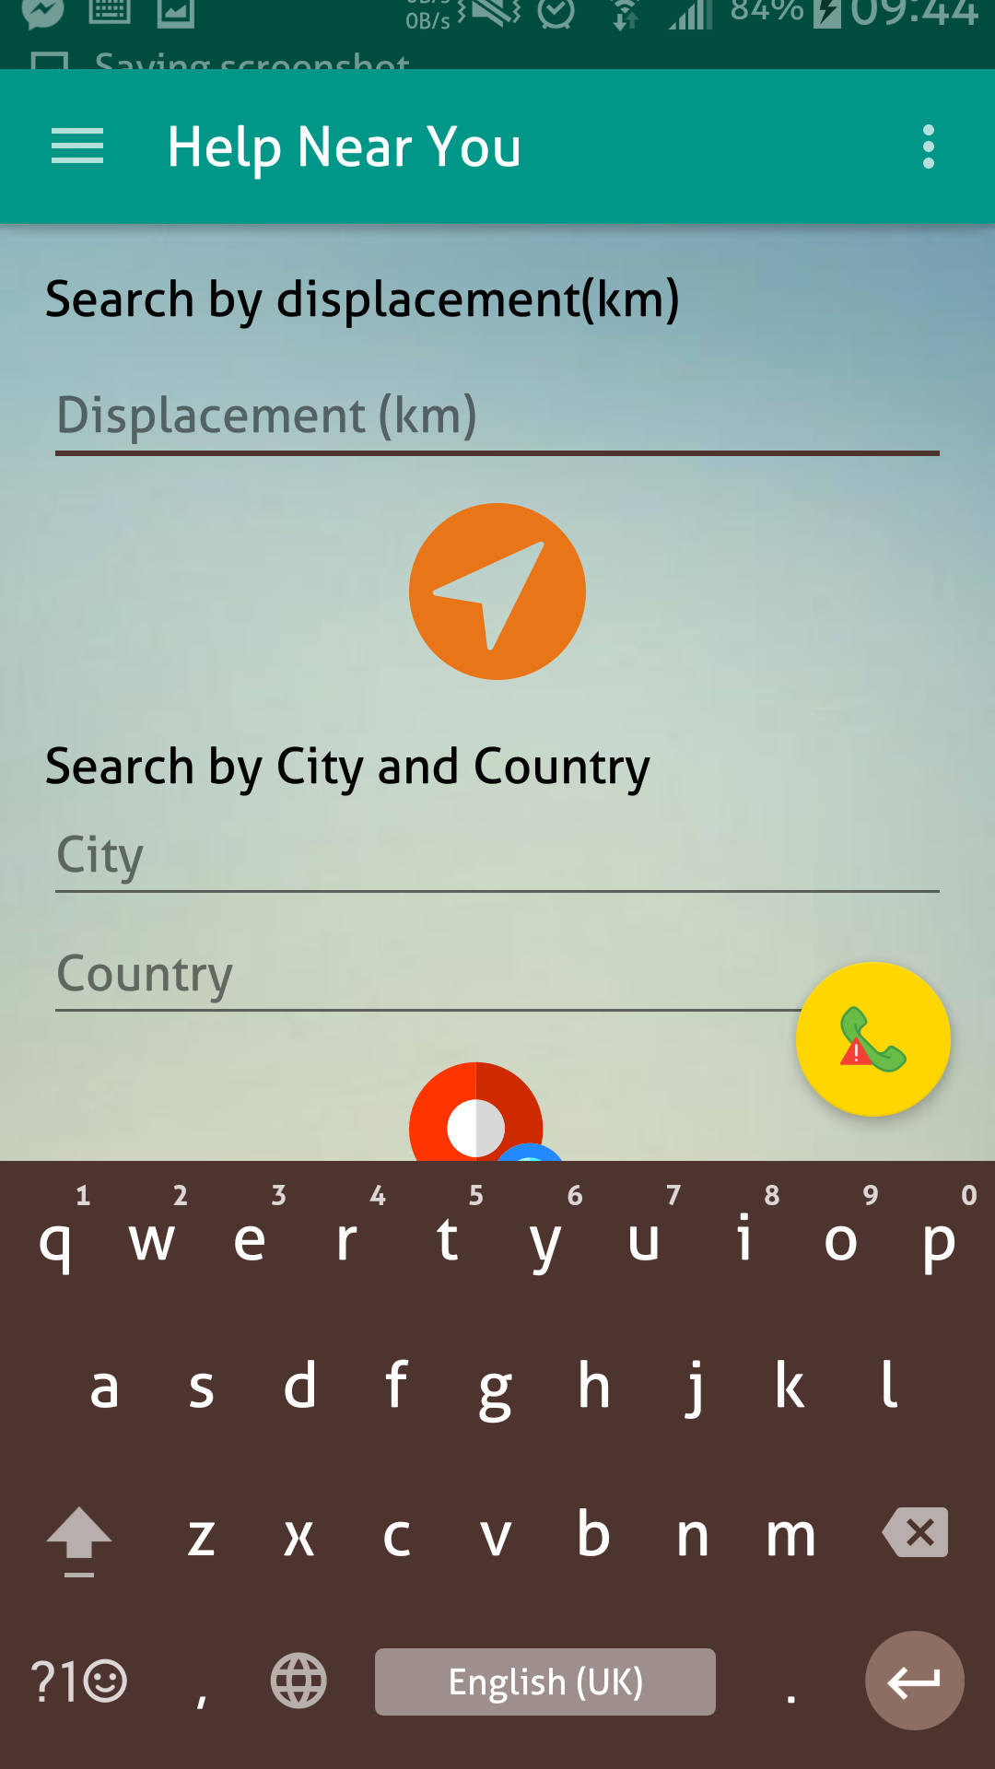
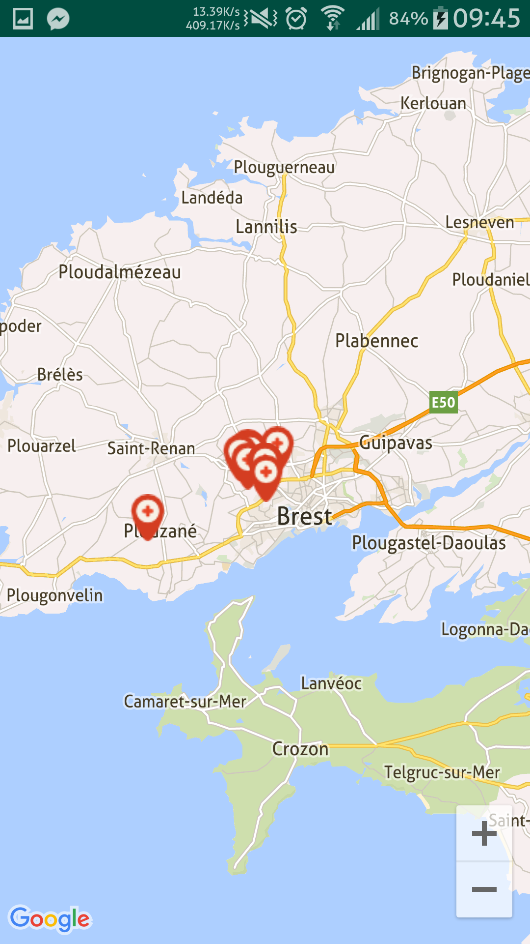
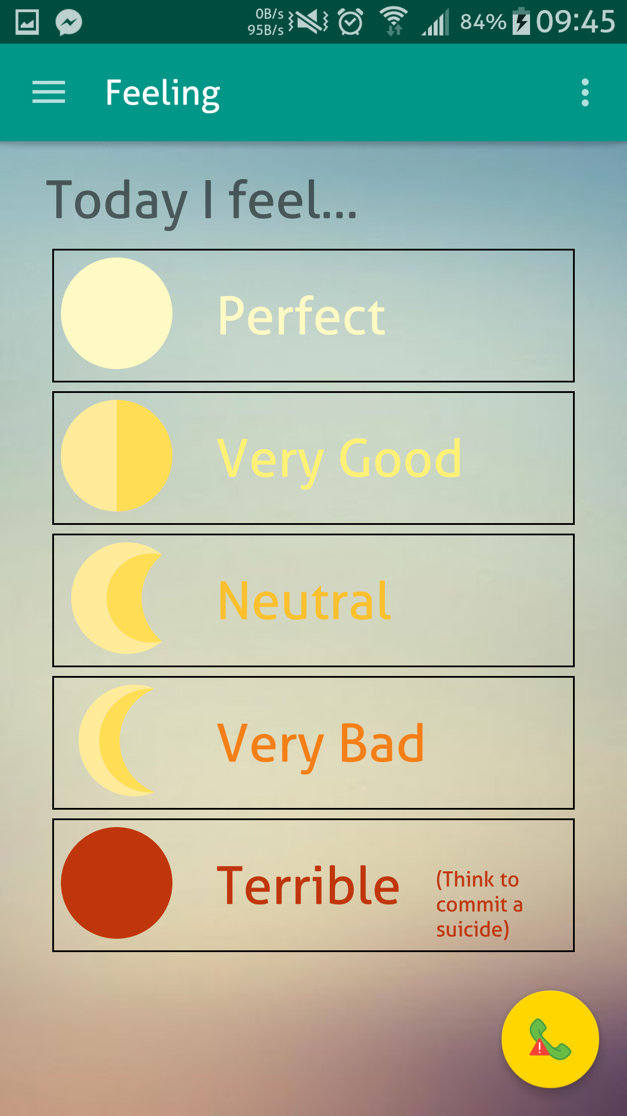
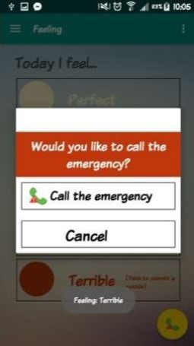
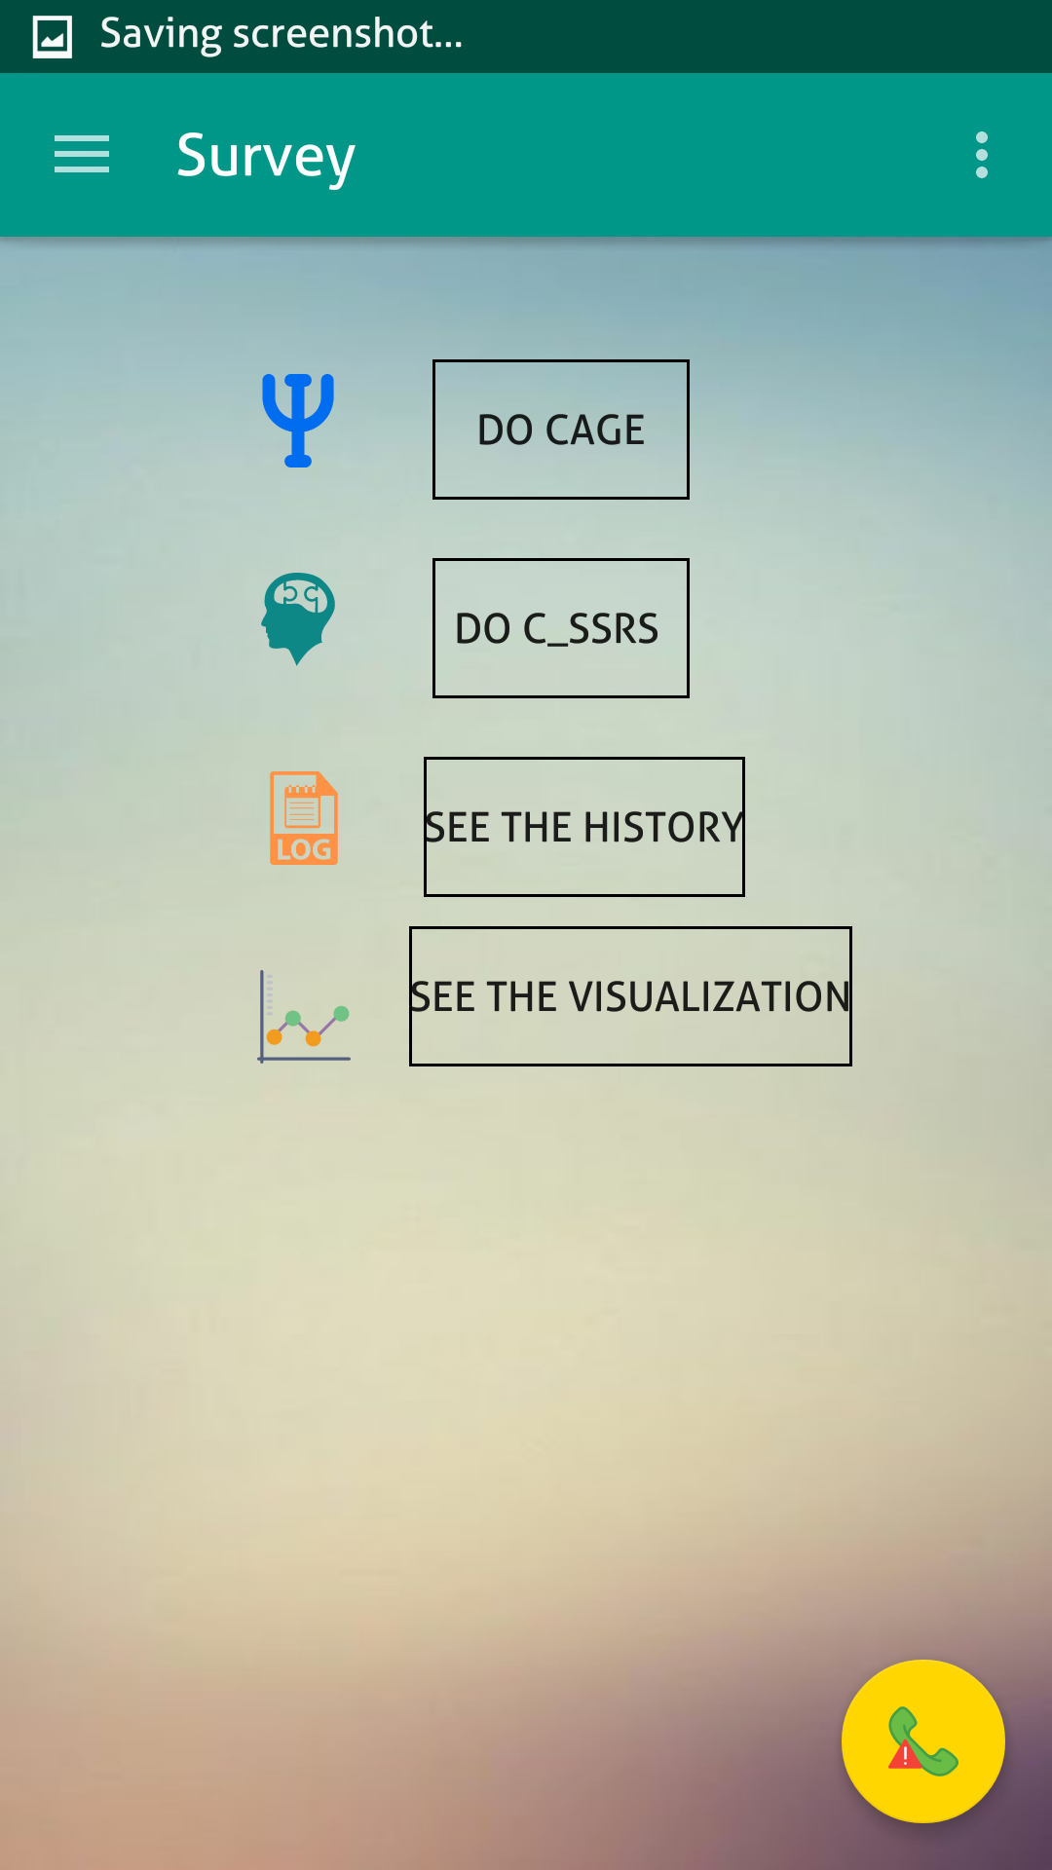
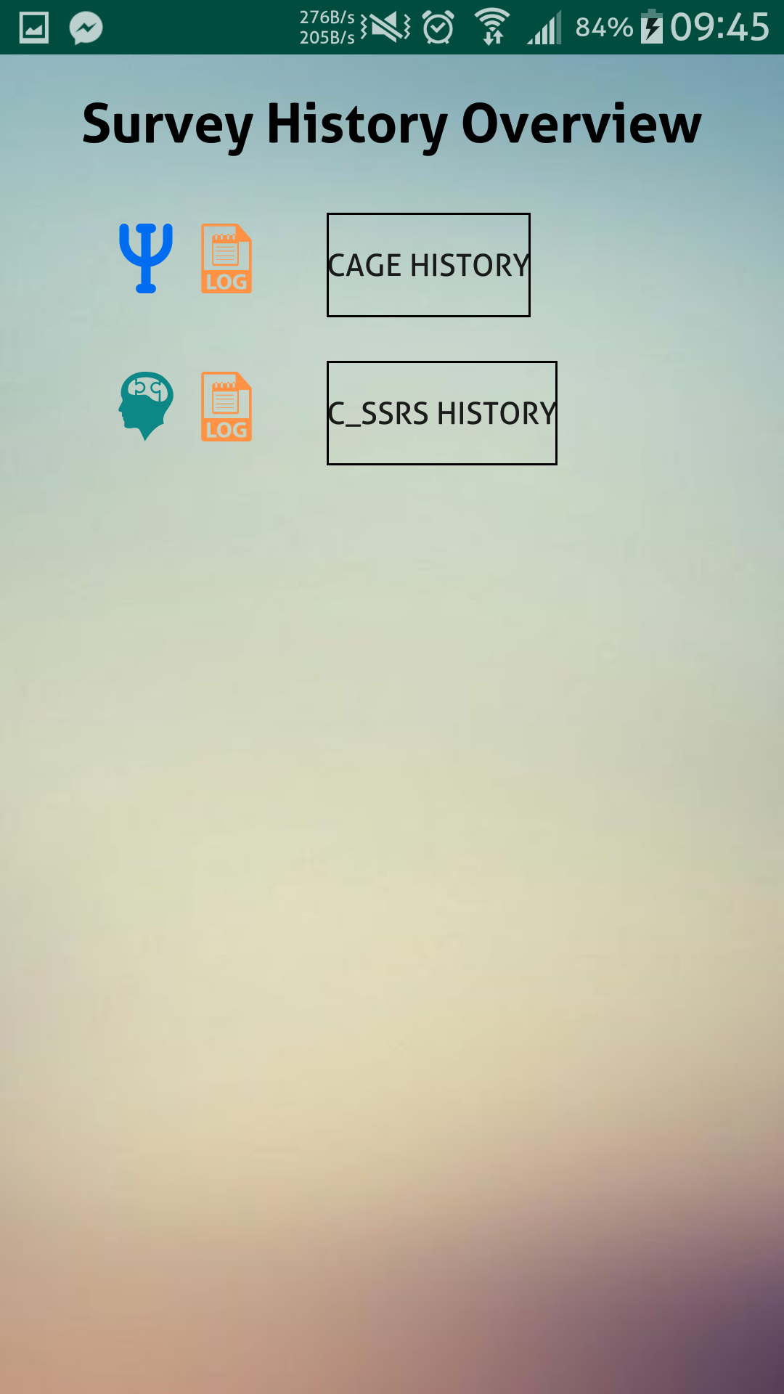
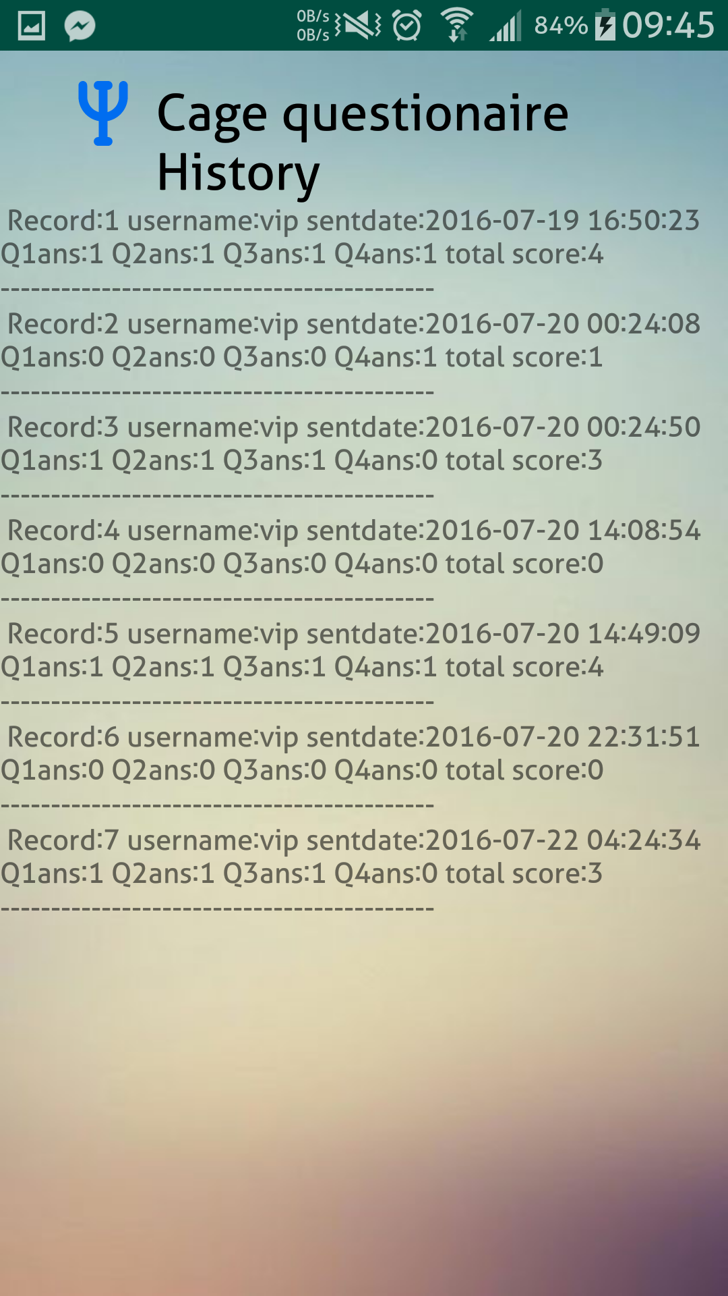
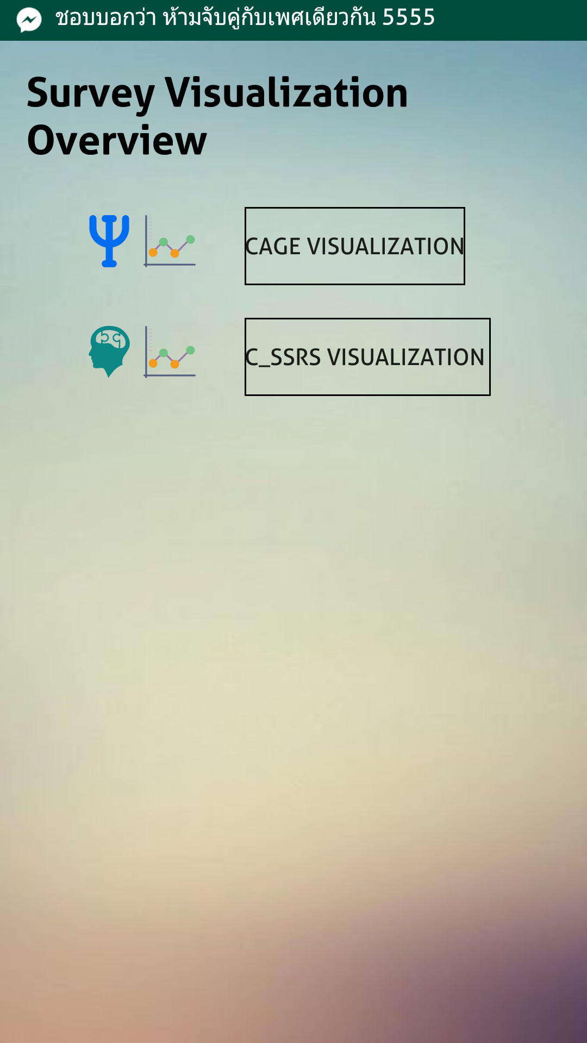
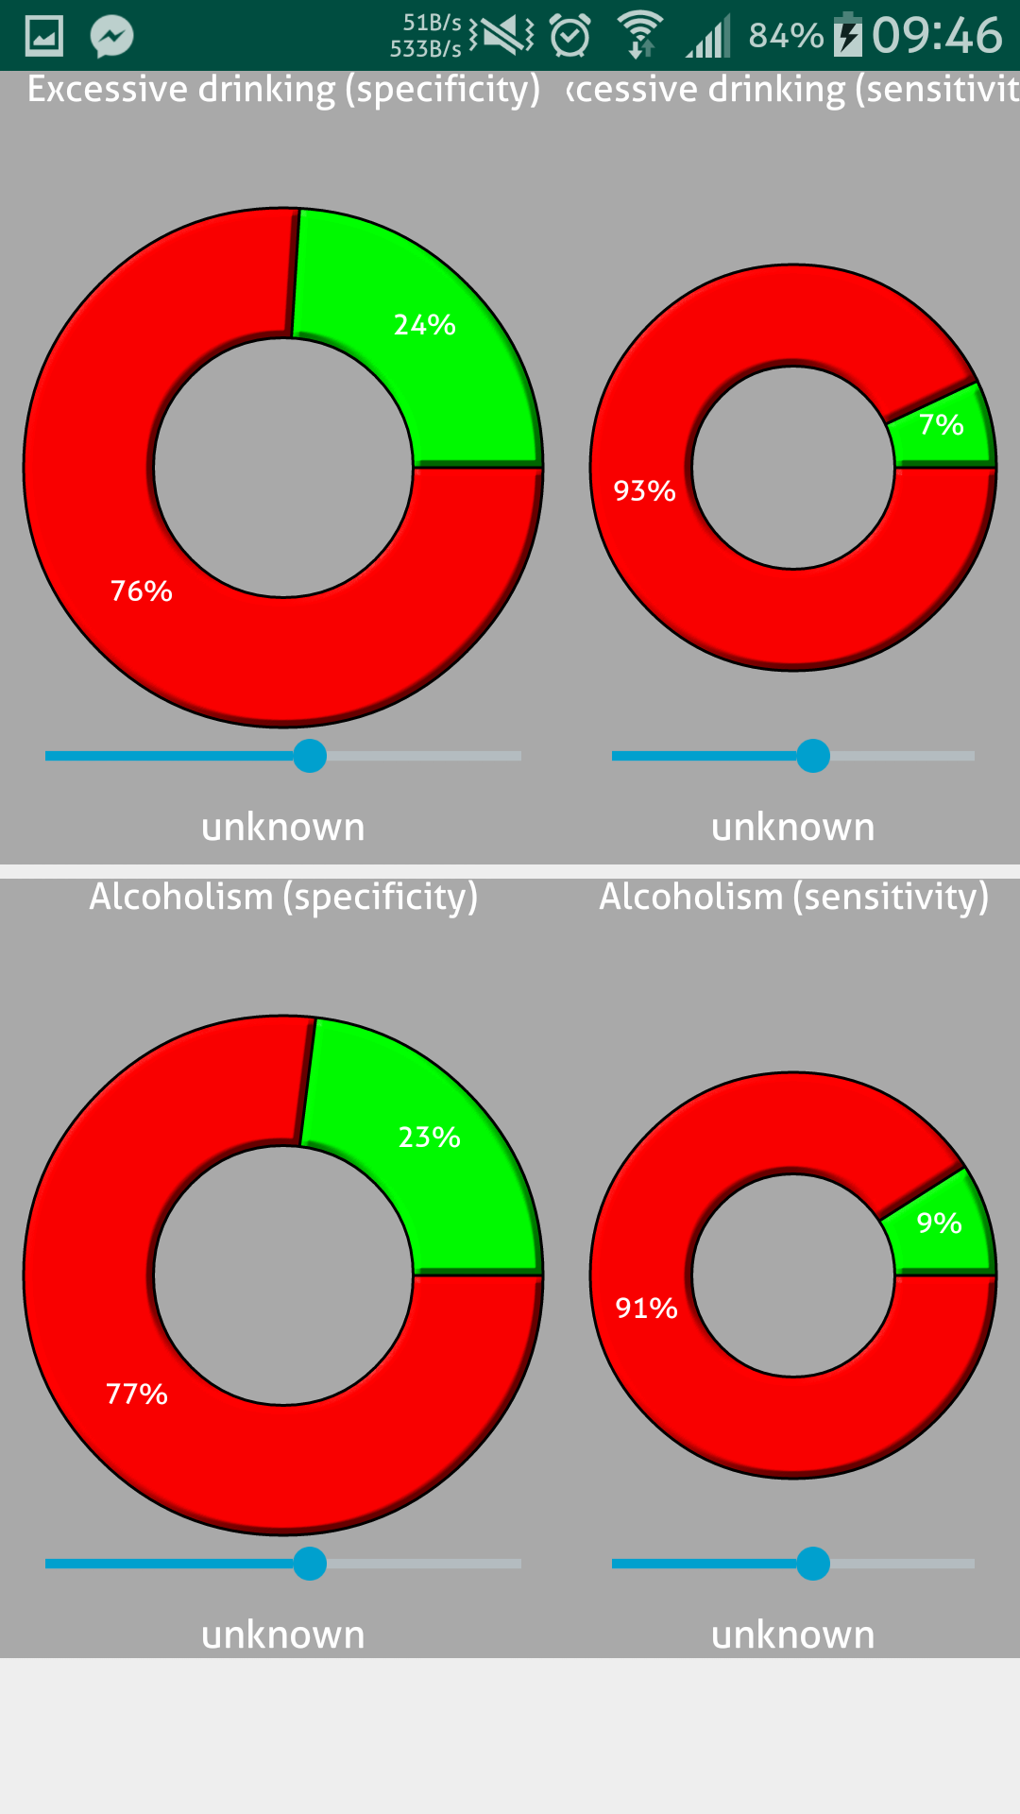
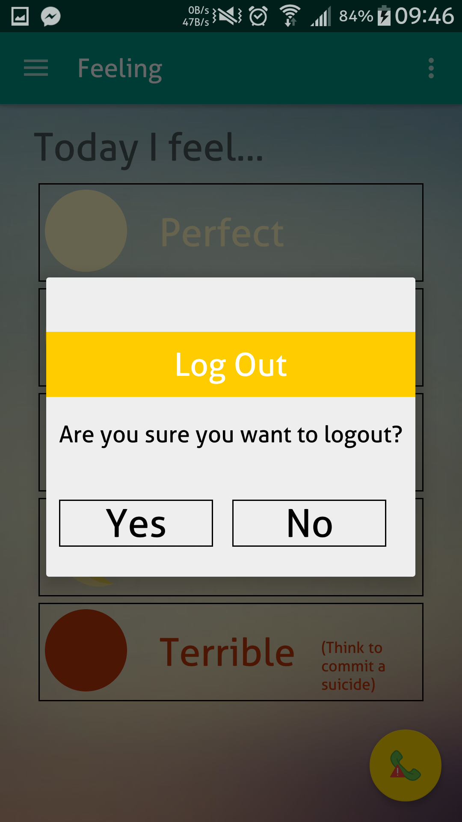
BeLeaf
A full-stack Android app for assessing mental health & preventing suicide.

Slide 2



BeLeaf
A full-stack Android app for assessing mental health & preventing suicide.
BeLeaf (Believe in a rainbow after the storm.)
Be like a leaf that sways when it faces the wind.
Be flexible with distress triggering depression, and find a way to relieve & eventually eliminate it.
Let this app help you !!!

Slide 3
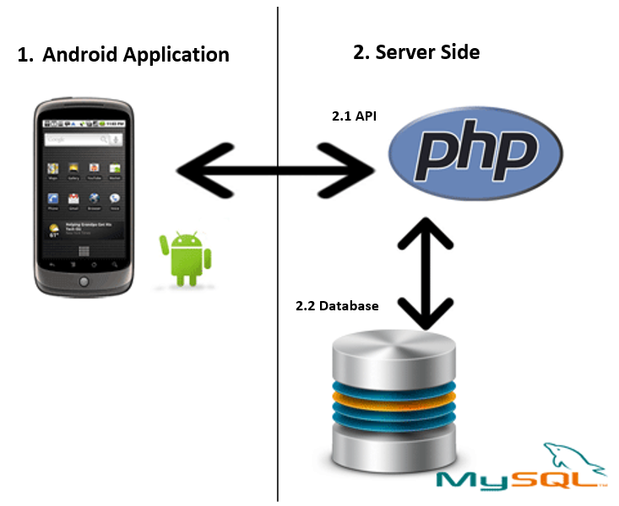
BeLeaf
A full-stack Android app for assessing mental health & preventing suicide.

Slide 4
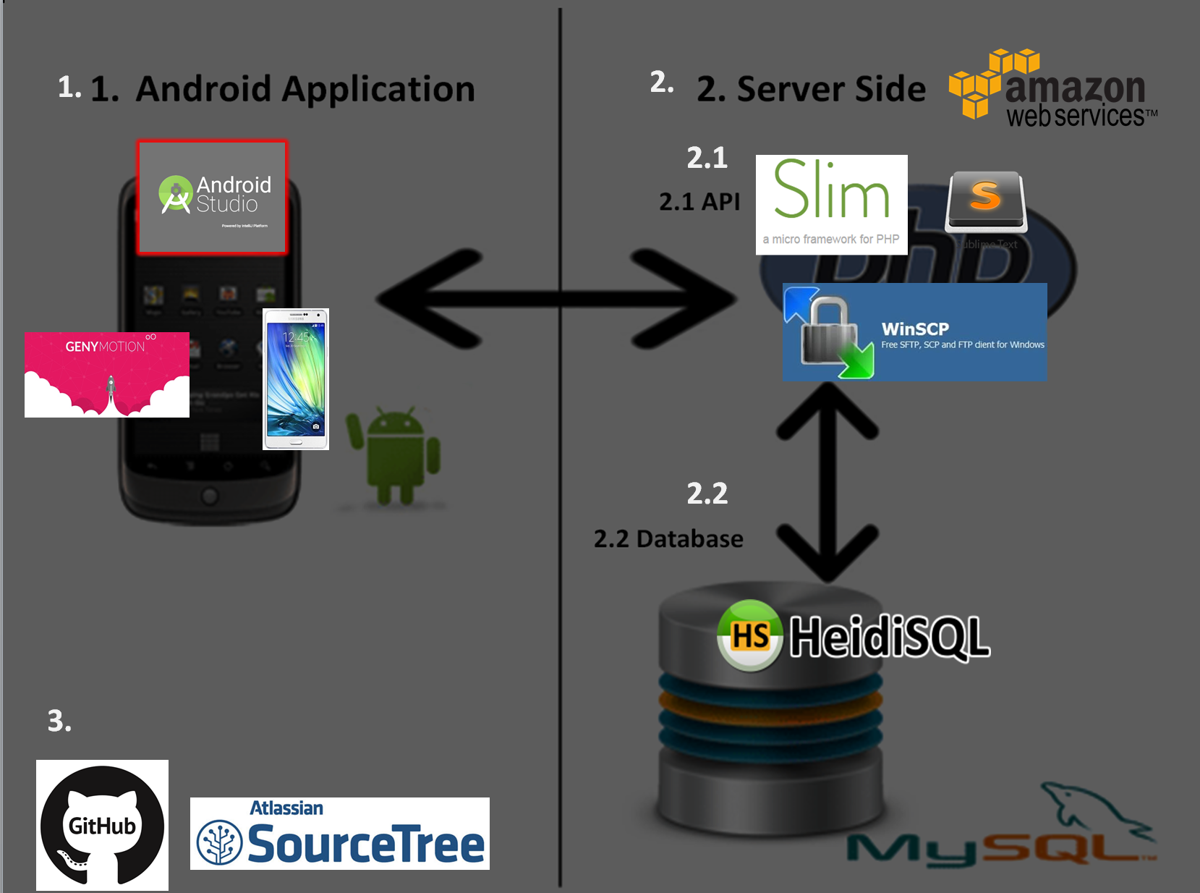
BeLeaf
A full-stack Android app for assessing mental health & preventing suicide.

Slide 5
BeLeaf
A full-stack Android app for assessing mental health & preventing suicide.
Open the app
Splash Screen
Login Menu

Slide 6
BeLeaf
A full-stack Android app for assessing mental health & preventing suicide.
Create an account
Login

Slide 7
BeLeaf
A full-stack Android app for assessing mental health & preventing suicide.
Home
Home (2)
Menu

Slide 8
BeLeaf
A full-stack Android app for assessing mental health & preventing suicide.
Your Space
Upload your memories here.
It preserves your memories through photos, videos, and diary.

Slide 9
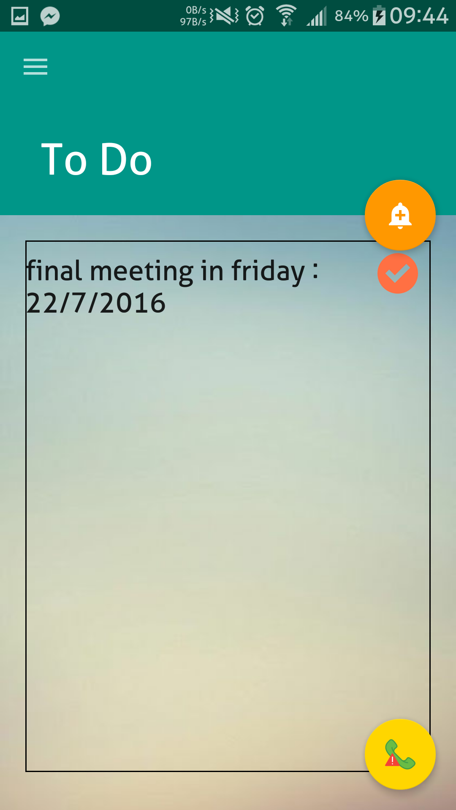
BeLeaf
A full-stack Android app for assessing mental health & preventing suicide.
To Do
Add your scheduled tasks & the dates here.
It displays your upcoming tasks & manages your time more effectively.

Slide 10
BeLeaf
A full-stack Android app for assessing mental health & preventing suicide.
Safety Planning
Add or delete your plans here.
It displays your plans &
facilitates the storage of their details.

Slide 11
BeLeaf
A full-stack Android app for assessing mental health & preventing suicide.
Help Near You
Search for the nearby support services here.
It displays the nearby support services on the map, helping you access one of them easier, due to severe depression.

Slide 12
BeLeaf
A full-stack Android app for assessing mental health & preventing suicide.
Feeling
Select how you are feeling today here.
Your feeling history is visualized
as line graph on Home.
Make an emergency call in case of needing help.

Slide 13
BeLeaf
A full-stack Android app for assessing mental health & preventing suicide.
Survey
Do the surveys & see your survey response-related history & the visualization from here.
// Remark: All the questionnaires are sensitive data.

Slide 14
BeLeaf
A full-stack Android app for assessing mental health & preventing suicide.
Survey Response-Related History
It displays your survey response-related history.

Slide 15
BeLeaf
A full-stack Android app for assessing mental health & preventing suicide.
Survey Response-Related Visualization
Your survey response-related data is visualized as charts here.

Slide 16
BeLeaf
A full-stack Android app for assessing mental health & preventing suicide.
Log Out

